Slide 1
Intro to Python
Workshop 2
Pitt INFORMS Student Chapter
Sept. 27, 2024

Slide 2
Outline
Short Workshop 1 Review
Installing Packages
NumPy
numpy.linalg
Matplotlib
Demo: Gradient Descent
Scikit-learn
Demo: Linear Regression

Slide 3
1 - Short Workshop 1 Review

Slide 4
Basic Data Types
Boolean
True / False values
Integer
Integer values (no issues with too big)
Float
Floating point numbers (double by default)
String
e.g. “Hello, world!”

Slide 5
More Data Types/Structures
List: [] or list()
Ordered, mutable
Set: {} or set()
Unordered, unique items
Dictionary: {} or dict()
Unordered, unique keys that are associated with values
Tuple: () or tuple()
Ordered, immutable

Slide 6
Control Flow
If-else
if: elif: else:
For loop
Can index over range object or the elements of a list.
While loop
Continues while condition is true
Try-except
Tries a piece of code and if error is raised goes to exception block.

Slide 7
Miscellaneous Python Things
Python uses indentations instead of brackets
Python is 0-indexing
range() and slicing is exclusive of end number
List comprehensions
[expression for item in iterable if condition]

Slide 8
Functions
Functions can be defined by the user or imported from existing packages.
Today, we will cover some commonly used packages.
def my_add(x, y):
return x + y
>>> my_add(2, 3.0) # 5.0
>>> import math
>>> math.log(2) # 0.693…

Slide 9
2 - Installing Packages
pip/conda install <package>

Slide 10
3 - NumPy

Slide 11
What is NumPy?
Fundamental package for numerical computing especially with multi-dimensional arrays.
Highly optimized for performance with operations in C and Fortran under the hood.
Enables element-wise operations and broadcasting.
Extensively used for data processing, simulation, machine learning, and more.

Slide 12
NumPy Array vs. Python List
Memory:
Array: Stored in contiguous blocks of memory, allowing for faster access and efficient memory usage. Needs same data type.
List: Store pointers to objects in memory, making them more flexible but less memory-efficient. Can have multiple data types.
Vectorized Operations:
Array: Element-wise operations and broadcasting.
List: Require looping which is slower and less efficient.
Performance:
Array: Leverages low-level optimizations (C and Fortran), making them significantly faster for numerical computations.
List: Slower for large datasets due to the lack of these optimizations and memory overhead.
---
These points highlight the differences in memory handling, data consistency, and performance between NumPy arrays and Python lists, making it clear why NumPy arrays are more efficient for numerical computing.

Slide 13
NumPy: array
import numpy as np
list1 = [1, 2, 3, 4, 5]
arr1 = np.array(list1)
print("Python List:", list1)
print("NumPy Array:", arr1)
type(arr1)
np.array() to convert list into a numpy array
Note that a NumPy array is its own data type called numpy.ndarray which stands for n-dimensional array.

Slide 14
NumPy:
Data Types
arr1 = np.array([1, 2, 3, 4, 5])
type(arr1[0]) # Output: numpy.int32
type(arr1[0] + 2**32) # Output: numpy.int64
arr1 += 2**32 # Overflow Error
The elements of array also numpy objects each with their own properties.
Type conversion is done behind the scenes.
Reminder: NumPy array has to have same data type.

Slide 15
NumPy: element-wise arithmetic
list1 = [1, 2, 3, 4, 5]
arr1 = np.array(my_list)
list1_sq = [x**2 for x in list1]
arr1_sq = arr1 ** 2
When performing arithmetic, you can write NumPy arrays as if they were ints or floats. The arithmetic will broadcast to every element of the array without the need for a for loop.

Slide 16
Numpy:
Generate Arrays
np.arange(0, 10, 2)
# Output: [0, 2, 4, 6, 8]
np.linspace(0, 1, 3)
# Output: [0., 0.5, 1.]
np.arange(start, stop, step)
Similar to range(), but returns a NumPy array.
np.linspace(start, stop, num)
Generates num evenly spaced numbers from start to stop (inclusive).

Slide 17
Numpy:
Generate Arrays
np.zeros(3) # [0., 0., 0.]
np.ones((2, 3)) # [[1., 1., 1.], [1., 1., 1.]]
np.random.rand(3) # [0.653, 0.742, 0.503] (random)
np.eye(2) # [[1., 0.], [0., 1.]]
np.zeros() generates an array of all 0s with the size specified. For >=2D array, use a tuple.
np.ones() does the same thing with all 1s.
np.random.rand() samples values from Uniform(0, 1).
np.eye() for identity matrix.

Slide 18
NumPy Arrays Faster at Arithmetic
import numpy as np
import time
size = 10**7 # 10 million elements
py_list, np_array = list(range(size)), np.arange(size)
start_time_list = time.time()
py_list_squared = [x ** 2 for x in py_list]
end_time_list = time.time()
start_time_np = time.time()
np_array_squared = np_array ** 2
end_time_np = time.time()
print(f"Time to square Python list: {end_time_list - start_time_list:.6f} seconds")
print(f"Time to square NumPy array: {end_time_np - start_time_np:.6f} seconds")

Slide 19
NumPy:
Array Arithmetic
v1 = np.array([1, 2, 3])
v2 = np.array([4, 5, 6])
v1 + v2 # Output: [5, 7, 9]
v1 * v2 # Output: [4, 10, 18]
v1 @ v2 # Output: 32
np.dot(v1, v2) # Output: 32
By default, arithmetic on multiple arrays will be treated element-wise.
For matrix multiplication use @.
Note: This carries over to higher dimension arrays.

Slide 20
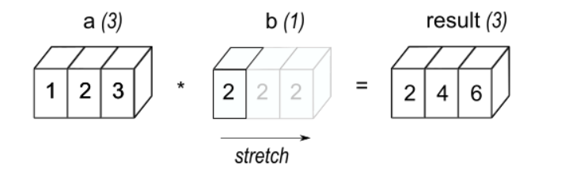
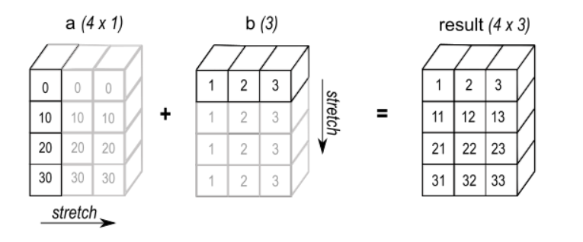
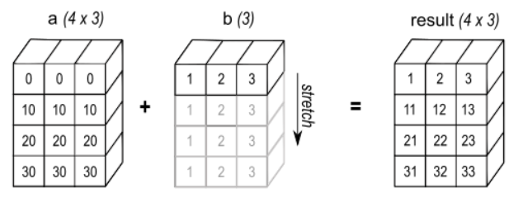
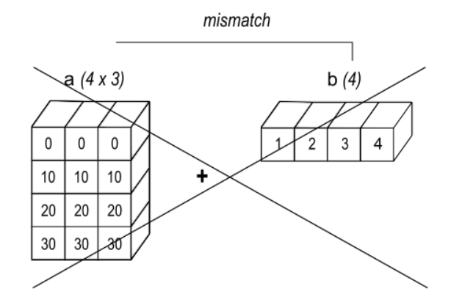
NumPy: Broadcasting

Slide 21
NumPy:
Broadcasting
a = np.array([1, 2, 3])
b = np.array([[1], [2], [3]])
a + b
# Output: [[2, 3, 4],
# [3, 4, 5],
# [4, 5, 6]]
Broadcasting stretches / repeats arrays to then perform element-wise arithmetic.

Slide 22
NumPy:
Indexing and Slicing
mat = np.array([[1, 2, 3], [4, 5, 6], [7, 8, 9]])
print(mat[1, 2])
# Output: 6
print(mat[0:2, :])
# Output: [[1 2 3]
[4 5 6]]
Note:
Python is 0-indexing
Python excludes the end of a range.

Slide 23
NumPy:
Indexing with Boolean Arrays
a = np.array([1, 2, 3])
print(a > 1] # Output: [False True True]
print(arr[a > 1]) # Output: [2, 3]
print(a[(a > 1) & (a < 3)]) # Output: [2]
Note that you can:
Generate a boolean array using conditions.
Index with a boolean array.

Slide 24
NumPy:
Aggregation Functions
a = np.array([[1, 2], [3, 4]])
print(np.sum(a)) # Output: 10
print(a.sum())) # Output: 10
print(np.sum(a, axis=0)) # Output: [4, 6] (sum along cols)
print(np.sum(a, axis=(0,1))) # Output: 10
NumPy arrays have functions such as sum and mean defined for the datatype.
You can use the axis argument to denote which dimensions you want to aggregate across.

Slide 25
NumPy:
Reshape and Flatten
a = np.array([[1, 2, 3], [4, 5, 6]])
a.reshape(3, 2) # Output: [[1, 2], [3, 4], [5, 6]]
a.flatten() # Output: [1 2 3 4 5 6]
a.transpose() # Output: [[1, 2, 3], [4, 5, 6]]
a.T() # Output: [[1, 2, 3], [4, 5, 6]]
reshape(): Reshapes array. Product of dimensions must remain the same.
flatten(): Converts a multi-dimensional array into a 1D array.
transpose() or .T: Transposes the array

Slide 26
NumPy: Combining Arrays
a = np.array([[1, 2], [3, 4]])
b = np.array([[5, 6]])
# Vertical Stack np.concatenate((a, b), axis=0) # Output: [[1, 2], [3, 4], [5, 6]]
# Horizontal Stack np.concatenate((a, b.T), axis=1) # Output: [[1, 2, 5], [3, 4, 6]]
concatenate(): used to join two or more arrays along an existing axis.
Arrays must have matching dimensions (except in the concatenation axis).
By default, along the first axis (axis=0), but can specify (e.g., axis=1 for horizontal concatenation).

Slide 27
Practice Problems Set 1 - NumPy
Create an array of numbers from 0 to 20.
Create a new array keep only numbers not divisible by 3.
Create an array of 5 equally spaced values in [0, 1).
Let A = np.array([[1,2], [3,4]])
Find the sum.
Find the index of the element with maximum value.
Reshape the array to be 1x4
Reshape the array to be 4x1.

Slide 28
4 - numpy.linalg

Slide 29
NumPy: Solving a Linear System
A = np.array([[1, 2], [3, 4]])
b = np.array([5, 11])
x = np.linalg.solve(A, b)
print(x)
# Output: [1., 2.]
np.linalg.solve(): Solves a linear system (Ax=b) and returns the solution to the system.

Slide 30
NumPy: Inverting a matrix
A = np.array([[1, 2], [3, 4]])
A_inv = np.linalg.inv(A)
print(A_inv)
# Output: [[-2., 1.], [1.5, -0.5]]
b = np.array([5, 11])
A_inv @ b
# Output: [1., 2.]
Use np.linalg.inv() to compute the inverse (for singular matrix, computes the least squares approximation)

Slide 31
NumPy: Determinant
A = np.array([[1, 2], [3, 4]])
det_A = np.linalg.det(A)
print(det_A)
# Output: -2.0
np.linalg.det(): Computes the determinant

Slide 32
NumPy: Solving Singular Linear Systems
A = np.array([[1, 2], [2, 4]])
b = np.array([5, 10])
try:
x = np.linalg.solve(A, b)
except np.linalg.LinAlgError as e:
print(f"Cannot solve: {e}")
print("det: {np.linalg.det(A)}")
x = np.linalg.pinv(A) @ b
print(x) # [1, 2]
An example of how to use try-except.
np.linalg.solve() will return an error if A is singular.
Could compute pseudo-inverse instead if normal approach fails, using np.linalg.pinv().

Slide 33
Eigenvalues and eigenvectors
A = np.array([[1, 2], [3, 4]])
eigvals, eigvecs = np.linalg.eig(A)
print(eigvals) # [-0.37, 5.37]
print(eigvecs) # [[-0.82, -0.42], [0.57, -0.91]]
np.linalg.eig: returns a 2-tuple containing a list of eigenvalues (in ascending order) and a list of lists with the corresponding eigenvectors

Slide 34


Aside on Linear Regression
Two approaches to solving linear regression.
Solve the Normal Equations: (will do with NumPy)
Minimize Sum of Squared Errors: (will do with gradient descent)

Slide 35
Problem Set 2 Setup (making data)
import numpy as np
t = np.linspace(0, 1, 1000)
t_col = t.reshape(-1, 1)
ones_col = np.ones((t.shape[0], 1))
X = np.concatenate((ones_col, t_col), axis=1)
noise = np.random.normal(0, 1, t.shape)
theta = np.array([4, 3])

Slide 36
Practice Problems Set 2 - linalg
Compute y = X^{T}(theta)+noise, the simulated observations.
Compute theta_hat = (X^{T}X)⁻¹X^{T}y.
Solve the linear system X^{T}X(theta_hat) = X^{T}y for theta_hat. (Note: It is much more efficient computationally to solve the linear system directly rather than computing the inverse and then matrix multiplication. i.e. part 3 better than part 2.)

Slide 37
5 - Matplotlib

Slide 38
What is matplotlib?
Popular plotting package based on MATLAB.
Supports a wide range of plot types (line, bar, scatter, histogram, etc.).
Integrates well with NumPy, pandas, and others

Slide 39
Basic Functionality
import matplotlib.pyplot as plt
x = [1, 2, 4]
y = [4, 5, 2]
plt.plot(x, y) # Line plot
plt.show()
plt.scatter(x, y) # Scatter plot
plt.show()

Slide 40
Adding Titles and Labels
plt.plot(x, y, label='1', color='blue')
plt.plot(x, y+1, label='2', color='red', linestyle='--')
plt.title("My Title")
plt.xlabel("My X Label")
plt.ylabel("My Y Label")
plt.legend()
plt.savefig("my_plot.png")
plt.show()
plt.title()
plt.xlabel()
plt.ylabel()
plt.legend()
plt.savefig()

Slide 41
Practice Problems Set 3 - matplotlib
Generate 1000 equally spaced values from -1 to 1 as x.
Compute y = sin(2 * pi * x)
Generate a line plot. You should label the axes and have a title. Save the plot as “sin_fig.jpg”.

Slide 42
Solution
import numpy as np
x = np.linspace(-1, 1, 1000)
y = np.sin(2 * np.pi * x)
import matplotlib.pyplot as plt
plt.plot(x, y)
plt.xlabel('x values')
plt.ylabel('y values')
plt.title(r'Plot of $\sin(2 \pi x)$ from -1 to 1')
plt.savefig('sin_plot.jpg')
plt.show()

Slide 43
6 - Demo: Gradient Descent

Slide 45
Gradient Descent Algorithm
def gradient_descent(coef, t, y, lr=1e-4, tolerance=1e-6, max_iter=1000):
history = []
for _ in range(max_iter):
predictions = predict(coef, t)
residuals = y - predictions
history.append((coef, error_function(coef, t, y)))
coef_new = coef - lr * gradient(residuals, t)
if np.linalg.norm(coef_new - coef) < tolerance:
break
coef = coef_new
return coef, history
# TODO: Functions for predict(), error_function(), gradient()

Slide 46
History Explanation
def gradient_descent(coef, t, y, lr=1e-4, tolerance=1e-6, max_iter=1000):
history = []
for _ in range(max_iter):
predictions = predict(coef, t)
residuals = y - predictions
history.append((coef, error_function(coef, t, y)))
coef_new = coef - lr * gradient(residuals, t)
if np.linalg.norm(coef_new - coef) < tolerance:
break
coef = coef_new
return coef, history
history is a list of tuples. Each tuple contains the current coefficients, a NumPy array, and the sum of squared errors (sse), as calculated with the function error_function(). Note: It is not necessary to track the complete history nor track sse at each iteration, but we will visualize these.

Slide 47
Gradient Descent Explanation
def gradient_descent(coef, t, y, lr=1e-4, tolerance=1e-6, max_iter=1000):
history = []
for _ in range(max_iter):
predictions = predict(coef, t)
residuals = y - predictions
history.append((coef, error_function(coef, t, y)))
coef_new = coef - lr * gradient(residuals, t)
if np.linalg.norm(coef_new - coef) < tolerance:
break
coef = coef_new
return coef, history
Start with an initial guess of coefficients. Compute the predictions and the residuals. Plug into gradient function to take a gradient step. Adjust our coefficient by moving a fraction (default here is 0.0001) of the gradient. Terminate if our gradient step is sufficiently small.

Slide 48
Gradient Descent Helper Functions
def predict(coef, t):
return coef[0] + coef[1] * t
# Not necessary for gradient descent in general
def error_function(coef, t, y):
predictions = predict(coef, t)
return np.sum((y - predictions)**2)
def gradient(residuals, t):
grad_intercept = -2 * np.sum(residuals)
grad_slope = -2 * np.sum(t * residuals)
return np.array([grad_intercept, grad_slope])

Slide 49
Generate Example and Run Method
# Generate data
np.random.seed(123)
n = 100
t = 2 * np.random.rand(n)
y = 4 + 3 * t + np.random.randn(n) # True intercept=4 and slope=3
# Run gradient descent
coef_init = np.array([0, 0])
final_coef, history = gradient_descent(coef_init, t, y)
print(f"Estimated coefficients (intercept, slope): {final_coef}")

Slide 50
Plot Points and Regression Line
plt.scatter(t, y, label='Data points')
plt.plot(t, predict(final_coef, t), color='black', label=f'Fitted line: y = {final_coef[0]:.2f} + {final_coef[1]:.2f}*t')
plt.xlabel('t')
plt.ylabel('y')
plt.legend()
plt.title('Linear Regression Fit Using Gradient Descent')
plt.show()

Slide 51
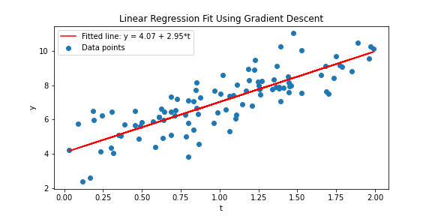
Plot Points and Regression Line

Slide 52
Compute Contours
history = np.array(history, dtype=object)
coef_vals = np.vstack(history[:, 0]) # Stack for 2D array for coefficients
error_vals = np.array(history[:, 1]) # Array of SSE values
theta0_vals = np.linspace(-5, 10, 400)
theta1_vals = np.linspace(-5, 10, 400)
Theta0, Theta1 = np.meshgrid(theta0_vals, theta1_vals)
Z = np.array([[error_function([theta0, theta1], t, y) for theta0, theta1 in zip(theta0_row, theta1_row)] for theta0_row, theta1_row in zip(Theta0, Theta1)])

Slide 53
Contour Plot with Descent Path
plt.contour(Theta0, Theta1, Z, levels=np.logspace(0, 5, 40))
plt.plot(coef_vals[:, 0], coef_vals[:, 1], 'r-o', label='Gradient Descent Path')
plt.xlabel('$theta_0$ (Intercept)')
plt.ylabel('$theta_1$ (Slope)')
plt.title('Contour Plot of Error Function with Gradient Descent Path')
plt.legend()
plt.show()

Slide 54
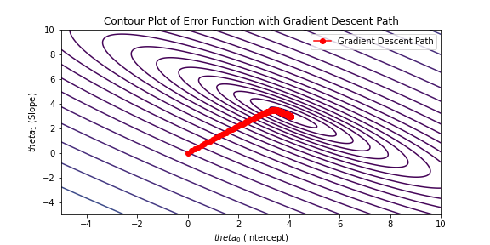
Contour Plot with Descent Path

Slide 55
Plot of SSE Values
plt.plot(range(len(error_vals)), error_vals, label='Sum of Squared Errors')
plt.xlabel('Iteration')
plt.ylabel('Error')
plt.title('Convergence of Sum of Squared Errors')
plt.legend()
plt.show()

Slide 56
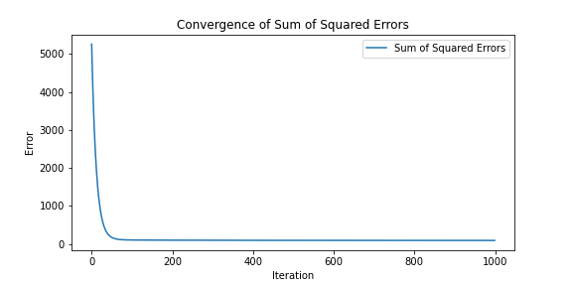
Plot of SSE Values

Slide 57
Using SciPy to Minimize Objective
from scipy.optimize import minimize
coef_init = np.array([0, 0])
result = minimize(error_function, coef_init, args=(t,y))
print(f'Solution: x = {x_min:.6f}, f(x) = {f_min:.6f}')
print(result)
In the previous example, we coded our own gradient descent function to minimize the objective.
Existing optimizers such as scipy.optimize.minimize exist and can be used out of the box.

Slide 58
Practice Problems Set 4
The equation x^2+y^2<= 1 defines a circle centered at the origin with radius 1. Also note that the area of a circle is A=𝜋*r^2.
Step 1: Define a function that
Randomly generate arrays of points x and y uniform on [0, 1].
Determines whether these points fall inside the quarter circle.
Determines the cumulative number of points in the circle that have been inside the quarter circle up to that point.
Multiply the array by 4 to estimate 𝜋 and return the array.
Step 2: Plot the running estimate of 𝜋 against the number of samples.

Slide 59
Solution (Estimation using NumPy)
import numpy as np
def estimate_pi(n: int) -> float:
x = np.random.uniform(0, 1, n)
y = np.random.uniform(0, 1, n)
is_inside = (x ** 2 + y ** 2 <= 1)
prop = np.cumsum(is_inside) / np.arange(1, n + 1)
result = 4 * prop
return result
n: int = 1e4
pi_estimates = estimate_pi(n)
print(pi_estimates)

Slide 60
Solution (Plotting using matplotlib)
plt.plot(np.arange(1, n + 1), pi_estimates, label = ‘Running Est of Pi’)
plt.axhline(y=np.pi, linestyle=’--’, label=f”True Pi = {np.pi:.8f}...”)
plt.xlabel(“#Samples (n)”)
plt.ylabel(“Estimate of Pi”)
plt.title(“Monte Carlo Estimation of Pi”)
plt.legend()
plt.show()

Slide 61
7 - Scikit-learn

Slide 62
8 - Demo: Linear Regression using scikit-learn

Slide 63
Import the necessary libraries
import numpy as np
import matplotlib.pyplot as plt
# Linear Regression methods
from sklearn.model_selection import test_train_split
from sklearn.linear_model import LinearRegression
from sklearn.metrics import mean_squared_error, r2_score

Slide 64
Load the iris dataset
# Load the iris dataset
from sklearn.datasets import load_iris
iris = load_iris()
X = iris.data[:, 2].reshape(-1, 1)
y = iris.data[:, 3].reshape(-1, 1)
# See structure of data
print(f”First 5 rows of X (Petal length): \n{X[:5]}”)
print(f”First 5 rows of Y (Petal width): \n{y[:5]}”)
Feature variable (X): Petal length (cm)
Target variable (y): Petal width (cm)

Slide 65
Preparing data for Linear Regression model
X_train, X_test, y_train, y_test = test_train_split(X, y, test_size = 0.2, random_state = 42)
# Shape of feature train and test set
print(f”Training set size: {X_train.shape}, Testing set size: {X_test.shape}”)
Split data into test and training sets into 80-20.
random_state: Integer value for seed for reproducing pseudo-randomness
Check the shape of the datasets, np.shape returns 2-tuple: (#rows, #columns)

Slide 66
Train the Linear Regression model
lin_reg = LinearRegression()
lin_reg.fit(X_train, y_train)
intercept: float = lin_reg.intercept_
slope: float = lin_reg.coef_
print(f”Intercept: {intercept}, Slope: {slope}”)
Instantiate the model
Fit to training features and labels
intercept_ and coef_ attributes of model contain the final parameter values

Slide 67
Making predictions
y_pred = lin_reg.predict(X_test)
print(f”Predictions: {y_pred}”)
print(f”Actual: {y_test}”)
plt.scatter(X_test, y_test, color = ‘blue’, label = ‘Actual Values’)
plt.plot(X_test, y_pred, color = ‘red’, label = ‘Predicted Values’)
plt.title(“Linear Regression”)
plt.xlabel(“Petal Length (cm)”)
plt.ylabel(“Petal Width (cm)”)
plt.legend()
plt.show()
Compute predicted labels using predict member function on test features.
Compare with actual labels (since this is a supervised setting)
Visualize the results using a scatter plot

Slide 68
Model evaluation
mse: float = mean_squared_error(y_test, y_pred)
r2: float = r2_score(y_test, y_pred)
print(f“Mean Squared Error (MSE): {mse}”)
print(f”R-squared: {r2}”)
def mae(y, y_hat) -> float:
Return np.mean(np.abs(y - y_hat))
mae: float = mae(y_test, y_pred)
print(f”Mean Absolute Error (MAE): {mae}”)
Compute mean squared error (MSE) and R^2 value
Can also define custom evaluation metric like mean absolute error (MAE)

Slide 69
Practice Problem using sklearn
Build a simple classifier using k-Nearest Neighbors (k-NN) to classify the iris flowers into one of the 3 species (setosa, versicolor, virginica) based on the four features: sepal/petal width/length and compute the accuracy.

Slide 70
Solution
from sklearn.datasets import load_iris
from sklearn.model_selection import train_test_split
from sklearn.neighbors import KNeighborsClassifier
from sklearn.metrics import accuracy_score
iris = load_iris()
X, y = iris.data, iris.target
X_train, X_test, y_train, y_test = train_test_split(X, y, test_size = 0.2, random_state = 42)
Import necessary statements
Load iris dataset
Split into test and training data
Use random state for reproducibility

Slide 71
Solution (cont.)
knn = KNeighborsClassifier(n_neighbors = 3) # n_neighbors = size of cluster
knn.fit(X_train, y_train)
y_pred = knn.predict(X_test)
accuracy = accuracy_score(y_test, y_pred)
print(f”Accuracy of k-NN classifier: {100. * accuracy:.2f}”)
Instantiate the k-NN model instance
Fit to training data
Predict on test features
Compute accuracy score between predicted and actual labels

Slide 72
More Practice
from sklearn.preprocessing import StandardScaler
# Useful when features are in different orders of magnitude
scaler = StandardScaler()
X_train_scaled = scaler.fit_transform(X_train)
X_test_scaled = scaler.transform(X_test)
# Fit on X_train_scaled
# Predict on X_test_scaled
# Note difference in accuracy
Vary the test-train split ratios and random state seed value to see how it affects accuracy.
Also test out different values for k and report the one that produces best test accuracy.
Use StandardScaler from sklearn.preprocessing to see how it affects performance.

Slide 73
Extra Resources

Slide 74
https://numpy.org/doc/stable/user/index.html
https://numpy.org/numpy-tutorials/
https://docs.scipy.org/doc/scipy/reference/generated/scipy.optimize.bisect.html

